Slide 1















EDA final project
presentation
Problem B: Power & Timing optimization using MBFF
Presented by B11007048 李兆翔
B11007050 李子杰

Slide 2
Agenda
01.
Introduction
02.
Data structures & Algorithms
03.
Results

Slide 3
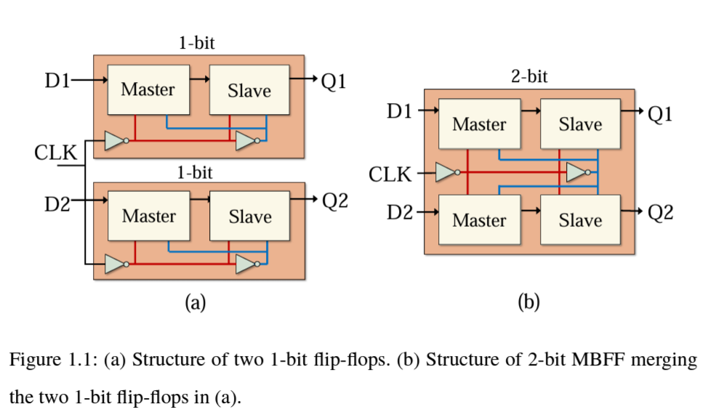
Introduction
Multi-bit FF decomposition / composition (map)
Minimize PPA, #violations of bin density, and TNS
ref: https://s-space.snu.ac.kr/bitstream/10371/196453/1/000000177339.pdf

Slide 4
Ideation process
01
02
03
Parser
ILP...?
Simulated
Annealing

Slide 5
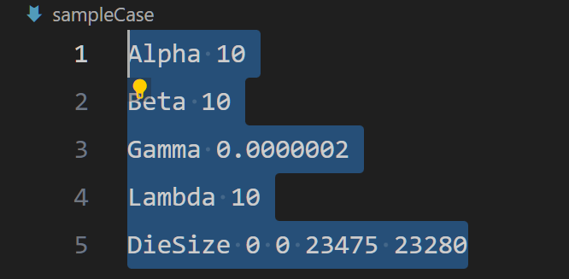
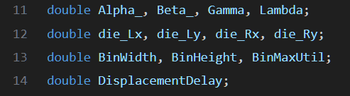
Parsing input data
Global parameters: treat as global variables
->
.
.
.

Slide 6
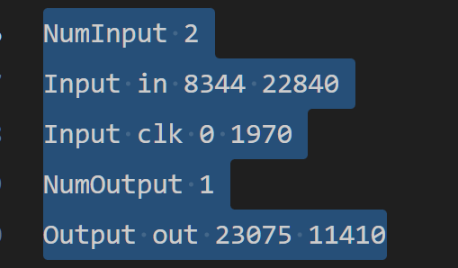
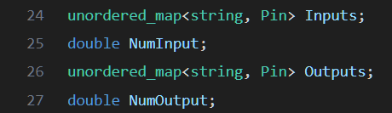
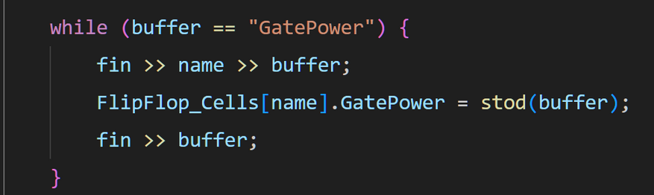
Parsing input data
Cell library, Instances, Nets : using “unordered map” to save particular data structures
->
.
.
.
input Data
e.g.: accessing FF cell library
using unordered map

Slide 7
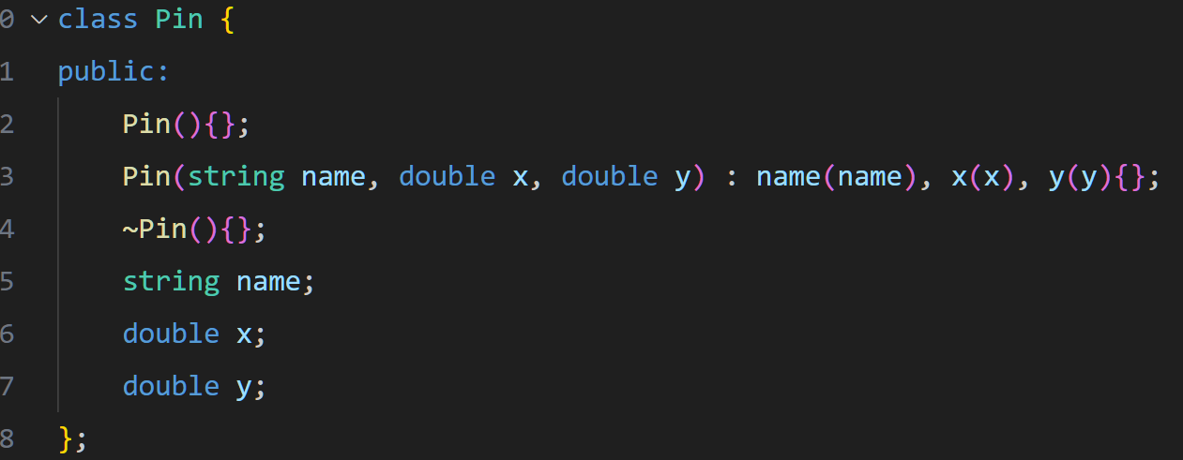
Data structures
(1) Pin: Store pin’s name, and x, y coordinates

Slide 8
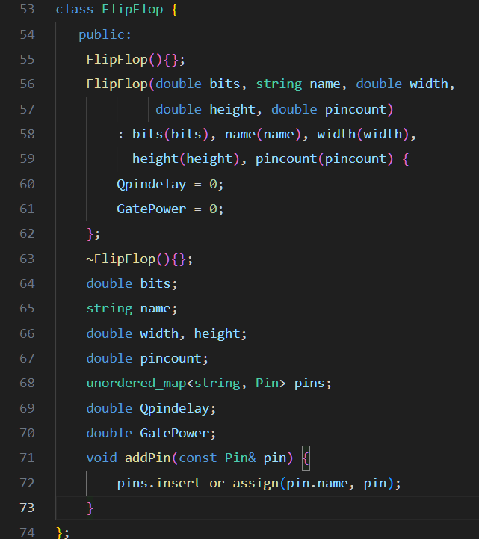
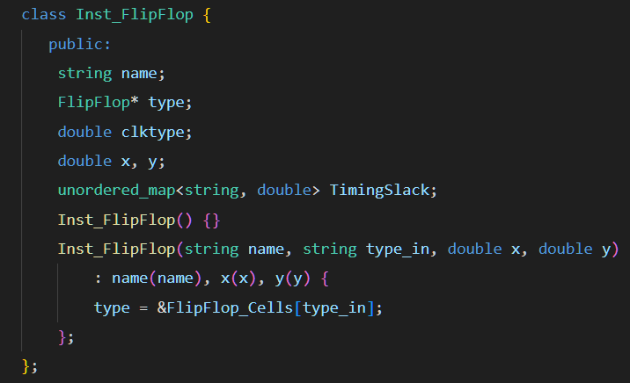
Data structures
(2) FFs: “FlipFlop” is for cell library, and
“Inst_FlipFlop” is for storing instances

Slide 9
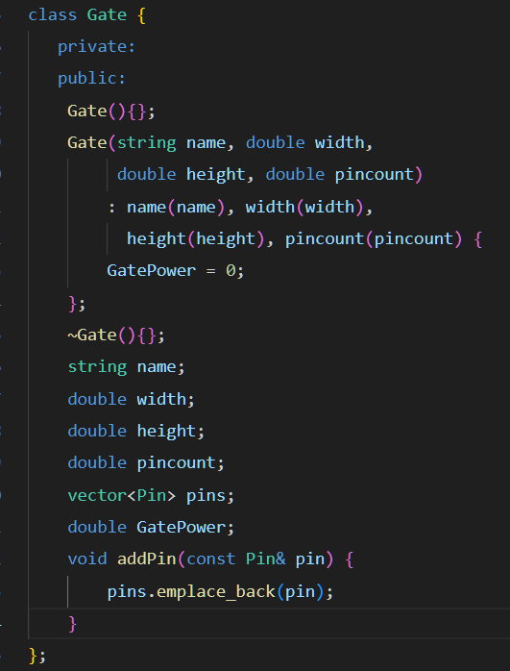
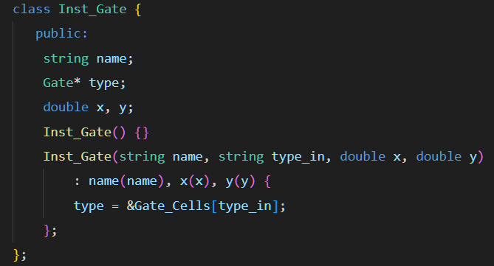
Data structures
(3) Gates: “Gate” is for cell library, and
“Inst_Gate” is for storing instances

Slide 10
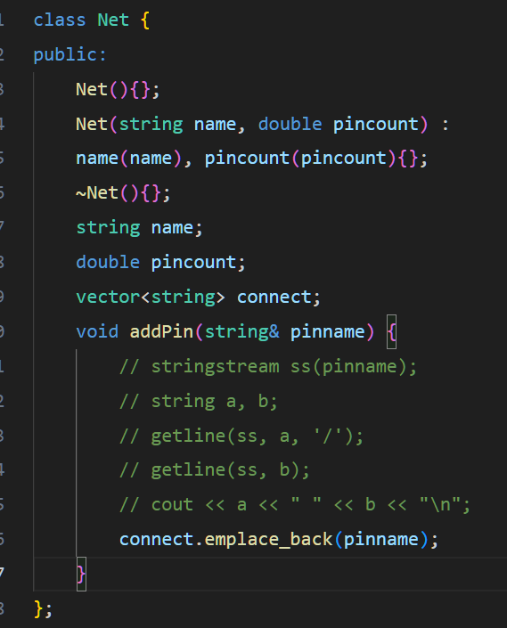
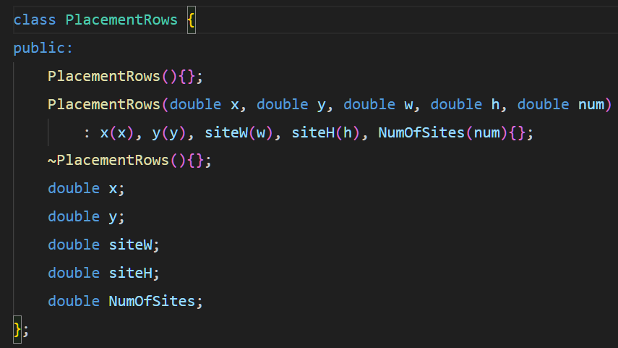
Data structures
(4) Nets & Placement Rows:

Slide 11
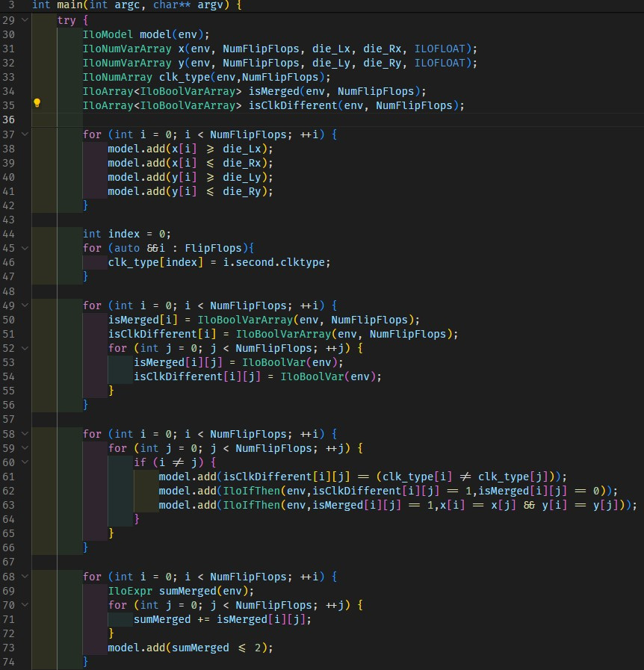
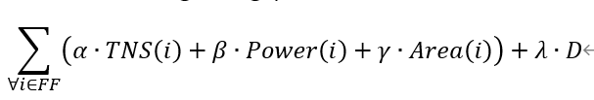
Using Cplex
Set objective function
Minimize
How to set Constraints ? ...
only same clks can bank together
nets are corrected connect
Instances are placed on-site
Instances are placed without overlap
more and more ...

Slide 12
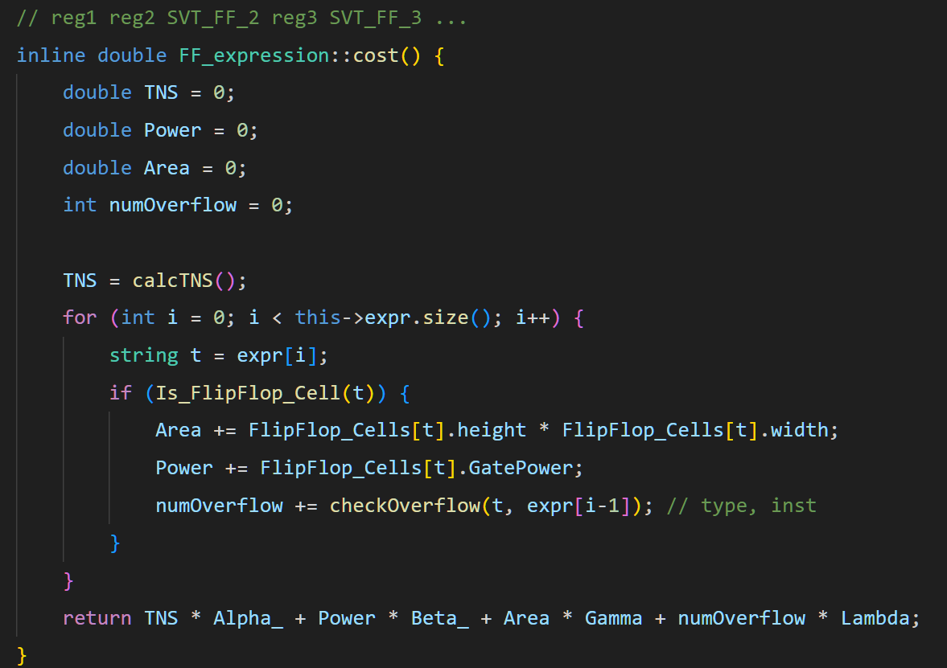
Simulated Annealing
1.cost
The cost is determined by following criteria:

Slide 13
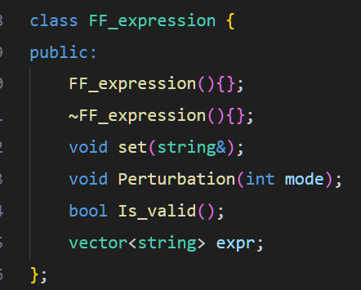
Simulated Annealing
2.Expression
contains idea from PA2
An expression with “instance” and “type”
Easier to do perturbation

Slide 14
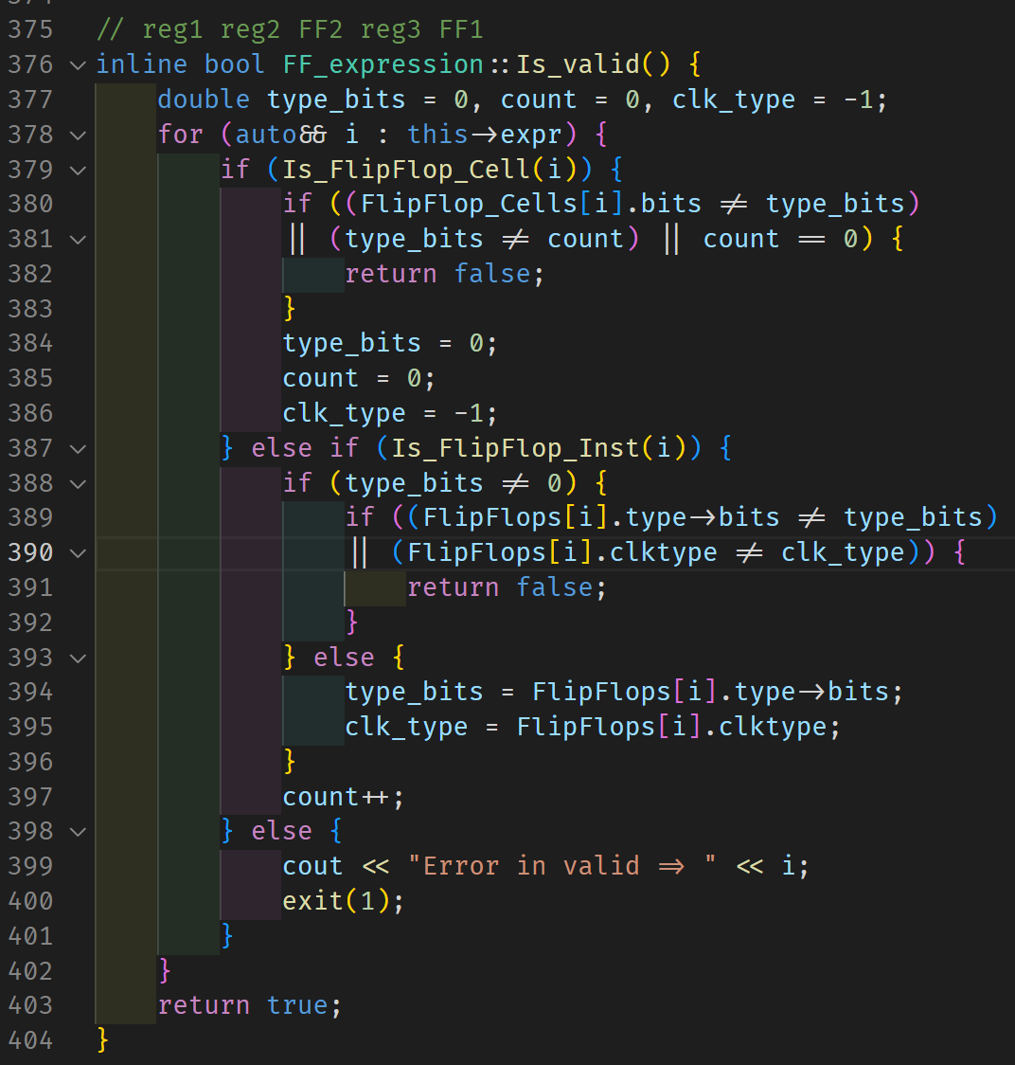
Expression validation
To maintain the correctness of expression, we require validation in the expression.

Slide 15
Simulated Annealing
3.Perturbation
Randomly choose a FF type from cell library, then merge(bank) or decompose(debank) the chosen instances
e.g.: Expr = reg1, reg2, SVT_FF_2, reg3, SVT_FF_1, reg4, SVT_FF_1
type = SVT_FF_2 (randomly choose)
the chosen instance(s) = reg3, reg4 (banking)
Expr = reg1, reg2, SVT_FF_2, reg3, reg4, SVT_FF_2

Slide 16
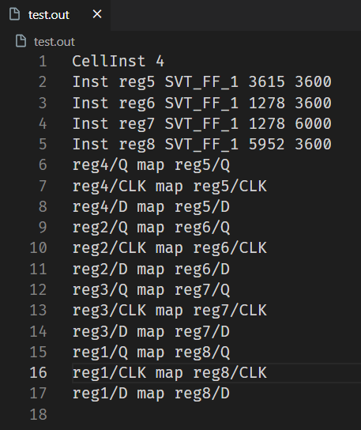
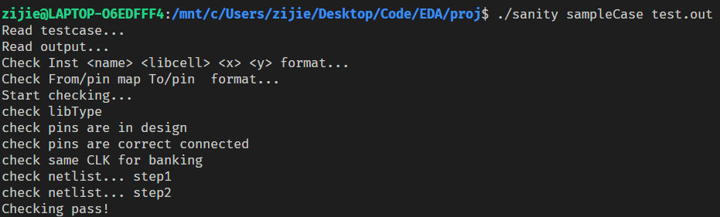
Simulated Annealing
4. Experimental results

Slide 17
Division of labor
 | B11007048 李兆翔 | B11007050 李子杰
文獻研究、討論 | ✔ | ✔
Parser |  | ✔
ILP |  | ✔
SA | ✔ | ✔
製作簡報 | ✔ | ✔
報告 | ✔

Slide 18
Thank you very much!

